Slide 1
Introductory General Chemistry
Chemistry 3A
S. M. Halloran

Slide 2
Mixtures: Heterogeneous & Homogeneous
Solutions & Aqueous Solutions
Solubility of Solids and Gases
Concentration: Percent of Dissolution, Molarity, Calculations
Colligative Properties, Molality, Freezing Point Depression, Boiling Point Elevation, Osmosis

Slide 3
Solutions
Solutions are homogeneous mixtures which are usually visibly liquid but can also be gaseous
Mixture: A combination of two or more substances that are physically mixed (not chemically bonded). Each substance retains its own chemical identity and can often be separated by physical means
Trail mix, sand and water are heterogeneous; saltwater and air are homogeneous
Homogeneous: Such mixtures are look like a single substance but are composed of two or more substances that are indistinguishable by eye
Saltwater, air, brass (a metal alloy).

Slide 4
Solutions
The solvent is the major component of the solution
The solute is the minor component of the solution
“Major” here means its mass or particle count (moles) is far larger than the mass or particle count (moles) of what is “minor”
Salt water has the minor component sodium chloride (NaCl) dissolved in the major component H₂O as its liquid (water)
Even air (the atmosphere) is considered a solution in which the solute diatomic oxygen (O₂) is dissolved in a solvent of diatomic nitrogen (N₂)
Air is 78% N₂ and 21% O₂

Slide 5
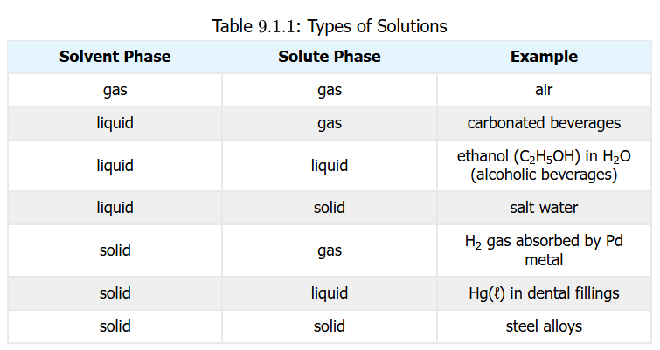
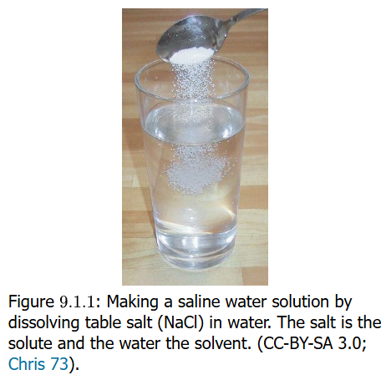
Solutions: Quiz Time
1.00 g sucrose (C₁₂H₂₂O₁₁) is dissolved in 100.0 g of H₂O liquid (water). What is the solvent and what is the solute?
The sucrose is clearly a minor component by mass compared to water. Sucrose is the solute, water the solvent
3.33 g HCl gas is dissolved in 40.0 g of CH₃OH (methanol, methyl alcohol). Identify solvent and solute
HCl (g) solute, CH₃OH (l) solvent

Slide 6
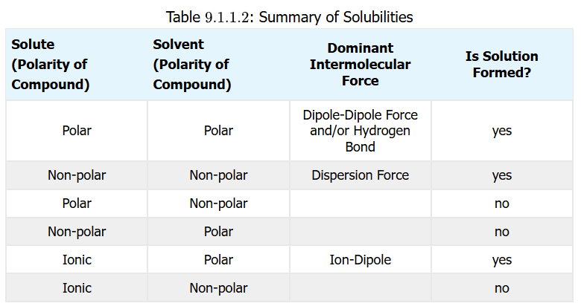
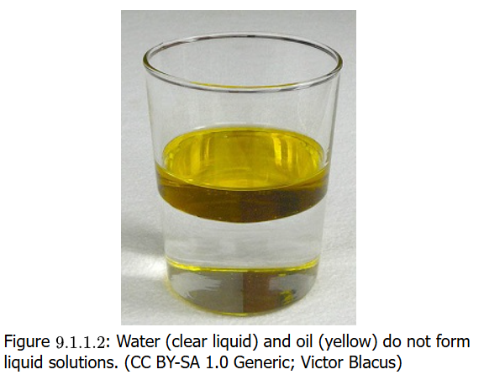
Will It Dissolve?
“Like dissolves like” generally
This means polar solutes in polar solvents. But ionic solutes also dissolve in polar solvents
Nonpolar solutes dissolve in nonpolar solvents
EXCEPTIONS: a very small amount (fraction) of nonpolar solutes mix polar solvents (O₂ and CO₂ dissolving in H₂O), and same for polar solutes in nonpolar solvents (water in oil)

Slide 7
Practice: Will It Dissolve?
Would I₂ (diatomic molecule iodine) be more soluble in CCl₄ (carbon tetrachloride) or H₂O (water)?
I₂ is nonpolar. CCl₄ is nonpolar and H₂O is polar, so expect I₂ to be much more soluble in CCl₄ than H₂O
Would C₃H₇OH (any of isomers of propanol) be more soluble in CCl₄ (carbon tetrachloride) or H₂O (water)?
C₃H₇OH is polar particularly because it is capable of hydrogen bonding, and H₂O also does hydrogen bonding. Expect C₃H₇OH to be much more soluble in H₂O than CCl₄

Slide 8
Practice: Will It Dissolve?
Which of these will be solutes in the solvent water?
Methanol (CH₃OH)
Both water and methanol have hydroxyl (–OH) functional groups that make these molecules polar. So they will mix
Note methanol (methyl alcohol) is a solvent in its own right: so two solvents that are mixed to form solution are said to be miscible
Sodium sulfate (Na₂SO₄)
Na₂SO₄ is an ionic compound. Ionic compounds have atoms (or polyatomic molecules as ions) that have permanent electric charge character, either positive (cationic) or negative (anionic) charge. These always prefer a polar than a nonpolar solvent, so will dissolve in water
Octane (C₈H₁₈)
C₈H₁₈ is a nonpolar compound. Compounds of just carbon and hydrogen will generally be nonpolar. So it will not dissolve

Slide 9
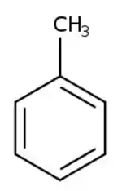
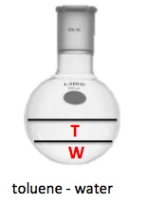
Practice: Will It Dissolve?
Which of these will be substances will dissolve in nonpolar solvent toluene (C₆H₅CH₃)
H₂O (water)
Water is quite polar. And following the rule of “like dissolves like” which means “polar dissolves polar” and “nonpolar dissolves nonpolar”, these will not mix (see image)
Na₂SO₄ (sodium sulfate)
It was noted that Na₂SO₄ is an ionic compound. Ionic compounds will interact with polar solvents ONLY
C₈H₁₈ (octane)
As a nonpolar compound, C₈H₁₈ will have no problem dissolving in a nonpolar solvent like toluene

Slide 10
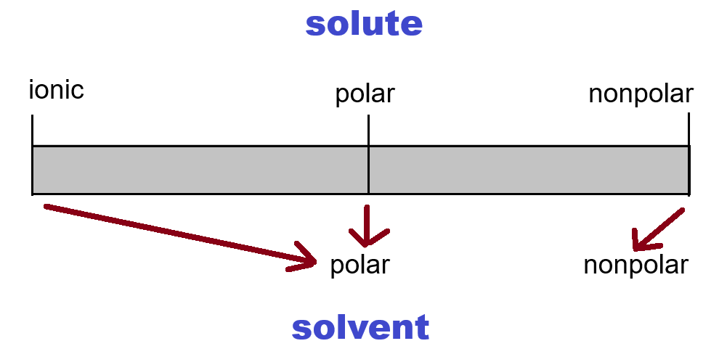
“Like Prefers to Dissolve in Like”
What about ionic solvents?
Yes there are ionic solvents
Molten salts (melted NaCl, KNO3, etc)
Room temperature ionic liquids (RTILs)

Slide 11
Electrolytes / Nonelectrolytes
Ionic compounds dissolving in a solvent create a solution with electrolytes
Substances dissolving but not being ions (ionic) in solution are nonelectrolytes
If the ionic solute dissolves (almost) entirely in the solvent, it is a strong electrolyte and a good conductor
If ionic solute dissolves only partially, it is likely a weak electrolyte and likely not a good conductor

Slide 12
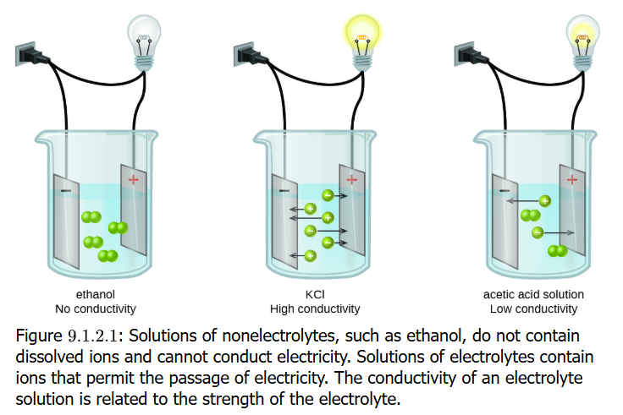
Carrying Electric Current
Aqueous solutions with dissolved electrolytes conduct electricity
The dissolved ions move freely in the solvent when an external voltage is applied
Dissolved ions of the one charge move to the electrode of opposite charge, creating the continuity that is the electric current If solute does not produce ions, there is no electric current

Slide 13
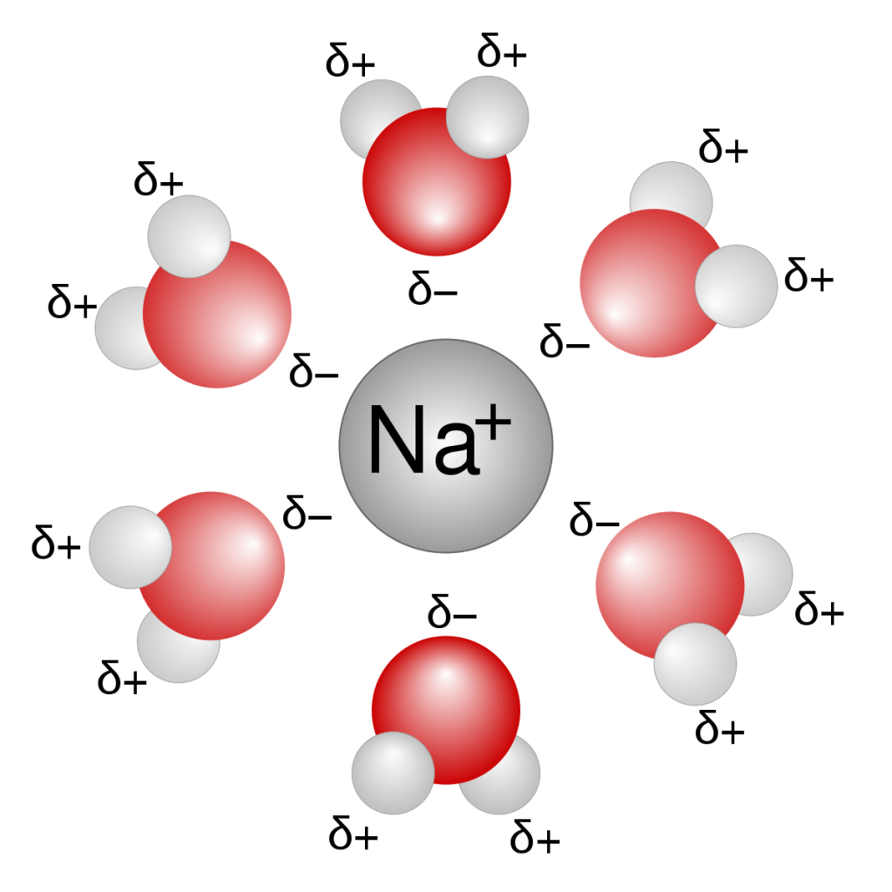
Ion-Dipole Attraction
Ionic compounds (salts) dissolve as ions in polar solvents like water
Water has no electric charge like a dissolved ion
But it DOES have a dipole (recall from previous unit)
That dipole in the H₂O molecule formed by the electron group & molecular geometry of the molecule enables interactions with dissolved ions
For NaCl (sodium chloride), note how the oxygen (O) atom with its negative dipole orients itself to Na⁺ (sodium) ions
And the hydrogen (H) atoms with their positive dipole will orient themselves to the Cl– (chlorine/ “chloride”) ions

Slide 14
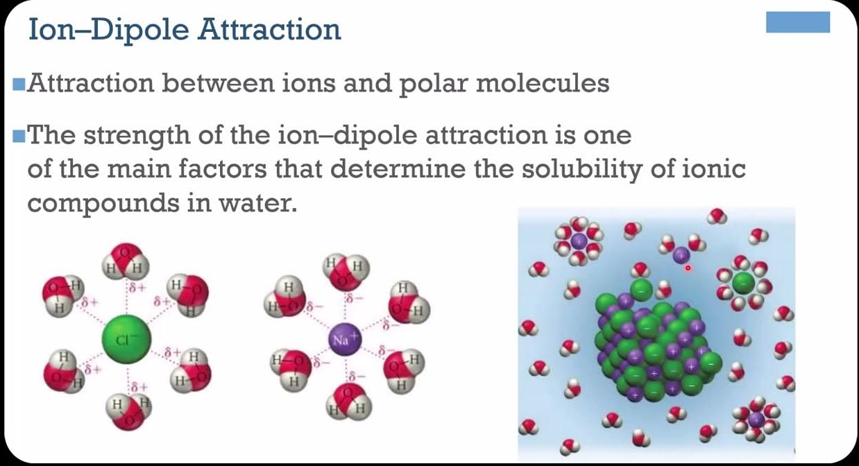
Ion-Dipole Attraction
The ion-dipole attraction actually helps to dissolve the salt crystal/solid
During the dissolution process, ions leave the solid (crystal) and are solvated in a physical process called dissociation, forming the electrolytic solution

Slide 15
Which Become Ions in Solution?
It needs to be an ion (an ionic compound)
Except for polyatomic molecules forming ions, molecules whether polar or nonpolar will not form ions!
LiF
yes
P₂F₅
no: all bonded are covalent and don’t break apart in a solvent
C₂H₅OH (CH₃CH₂OH) (ethanol)
no, a covalent molecule
C₆H₁₂O₆ (glucose)
no, a covalent molecule
CCl₄
no a covalent molecule and also nonpolar
CaCl₂
yes
AgNO₃
yes

Slide 16
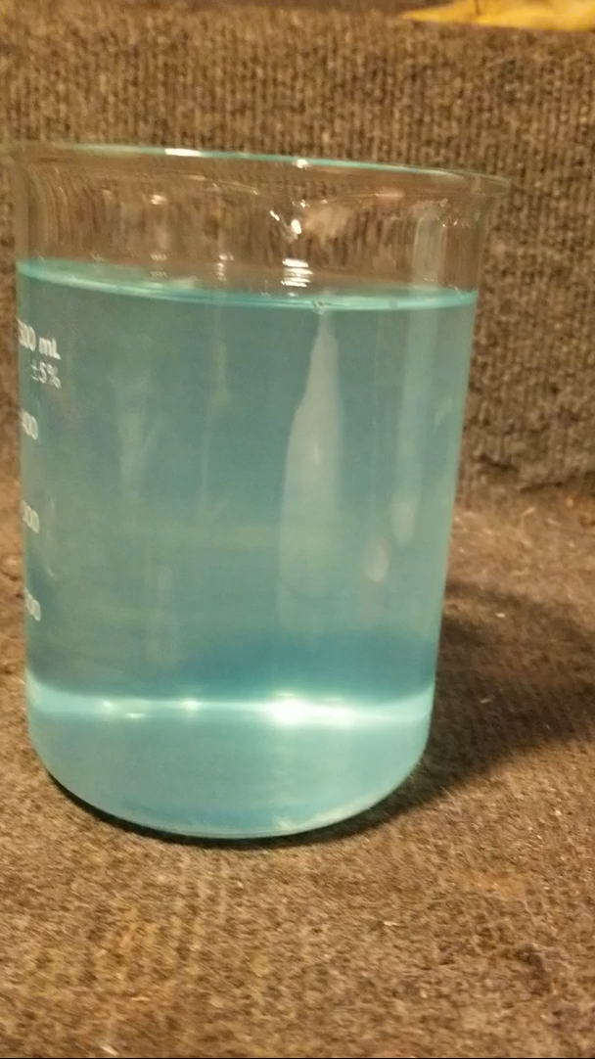
Solubility in Aqueous Solutions
Some ions (a cation and an anion) that are brought together in solution will form a complex quickly and precipitate out of solution, forming a solid in the solution
A classic example is silver (Ag⁺) cation binding or combining (not bonding) with chloride (Cl–) anion to form the silver chloride (AgCl) precipitate
Several ion combinations occurring in solution and having no or low solubility—thus forming precipitates— are known (table next page)
Video shows HCl being added to AgNO₃ (aq) to form AgCl (s)

Slide 17
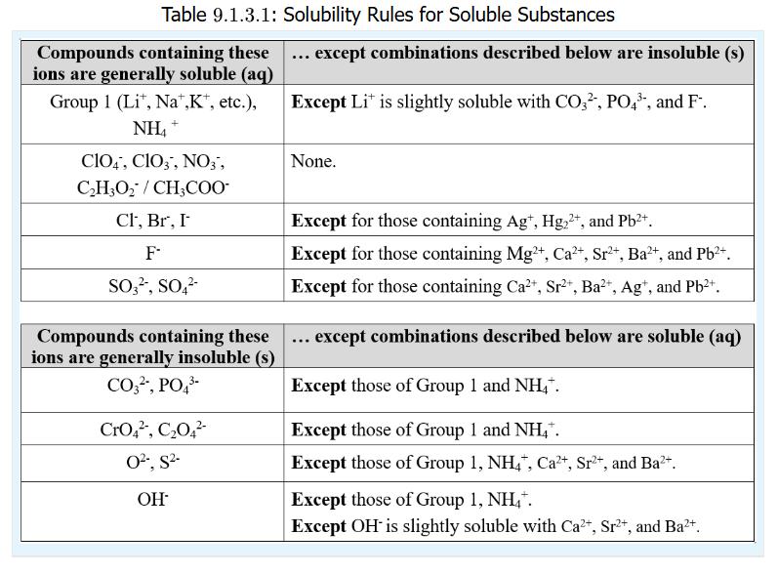
Solubility in Aqueous Solutions
These rules for solubility concerning the various ion combinations in aqueous solutions are part of the Green Sheet
If you are asked about whether the mixing of solutions with soluble ions form a precipitate, be prepared to say yes or no by understanding the table

Slide 18
Practice: Is It Soluble?
Refer to the Green Sheet
Zn(NO₃)₂ (zinc nitrate)
The solubility table indicates ALL nitrates are soluble
PbBr₂ (lead(II) bromide)
Table states all bromides are soluble except when combined with Pb²⁺ lead ion
Sr₃(PO₄)₂ (strontium phosphate)
Table states all phosphates are insoluble (not soluble), so Sr₃(PO₄)₂ is
Mg(OH)₂ (magnesium hydroxide)
The Group 2 ion is insoluble with hydroxide ion
KBr (potassium bromide)
Soluble: Group 1 ions like K⁺ are soluble except for Li⁺ in some combination
Pb(NO₃)₂ (lead(II) nitrate)
Table states all nitrates are soluble with no exceptions

Slide 19
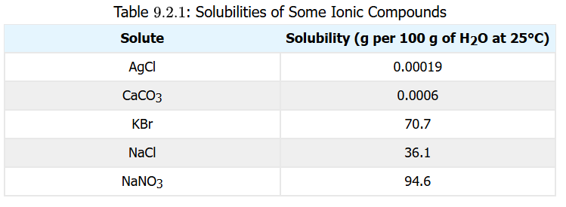
Solubility and Saturation
Some salt (cation-anion) combinations like silver chloride (AgCl) are not really soluble at all (see table below)
But many salts, while quite soluble, have a maximum limit of dissolution such that addition of more salt will NOT dissolve the added salt
The solute has reached a maximum saturation
Sodium chloride (NaCl) added above 36.1 g to 100 g H₂O will not dissolve the added NaCl.
The solution is said to be “saturated” with NaCl solute

Slide 20
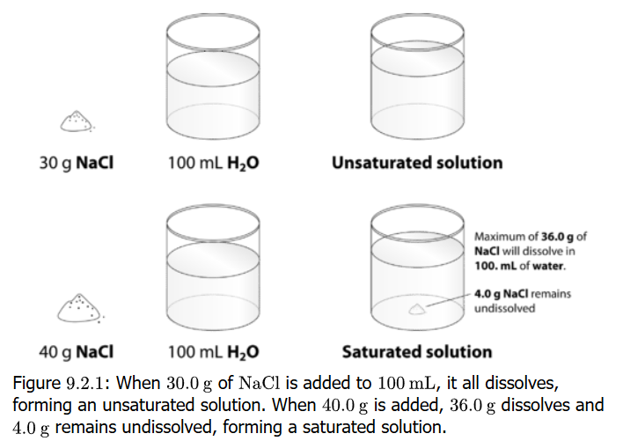
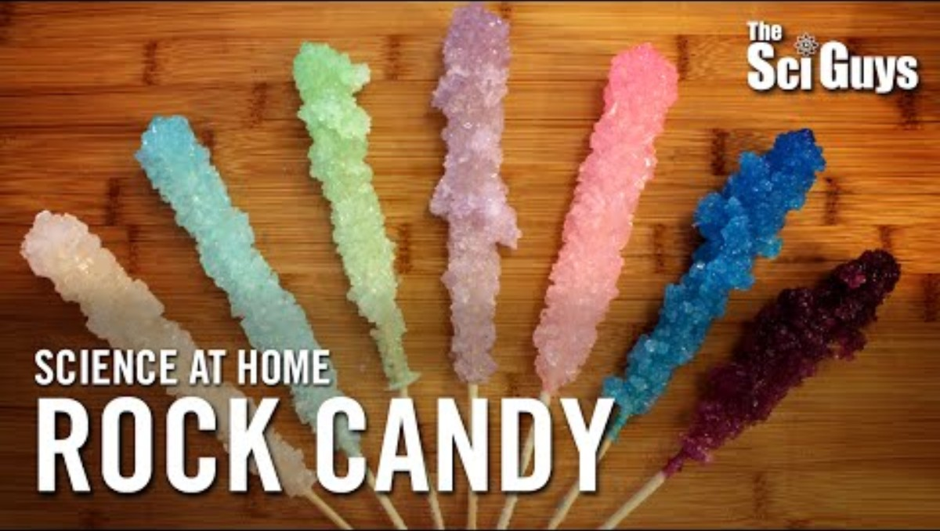
Saturated / Unsaturated
When a solute has not reached its maximum saturation, it is called unsaturated

Slide 21
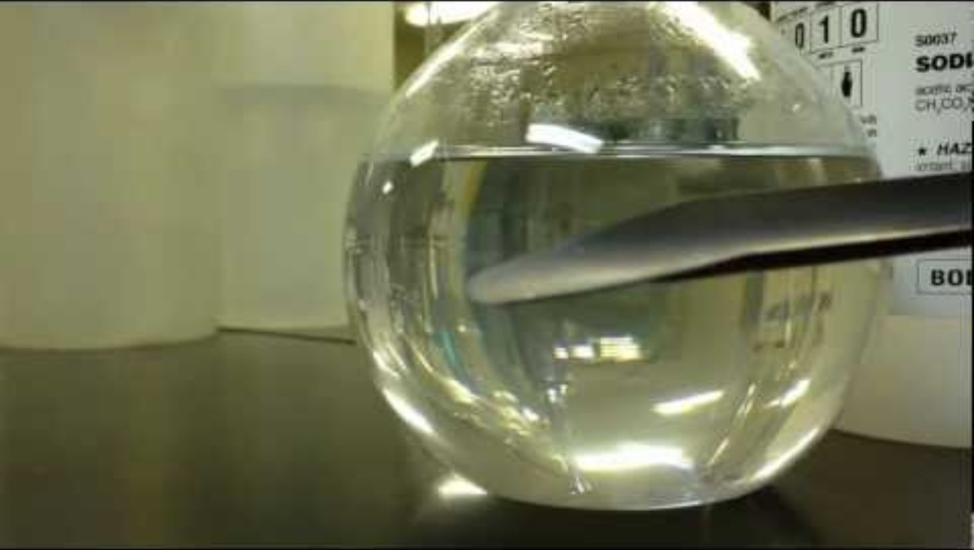
Supersaturation
Want to see something cool?
Add 175 g sodium acetate trihydrate (NaOOCCH₃ • 3 H₂O) to a 50 mL distilled water in a 500 mL Erlenmeyer flask
Heat flask inside a 2 L beaker containing 1.5 L water on hot plate until it dissolves
Invert 100 mL beaker over mouth of flask and allow to cool (a couple of hours)
Add a seed crystal or “scratch” the flask glass inside and watch the fun

Slide 22
Supersaturation
Maximum solubility (limits of saturation) are temperature-dependent
Solubility usually increases as the temperature goes up
Suppose you heat a solution and add solute up to its maximum solubility while make sure all solute dissolves
Now you cool the solution and solute mass is far above its maximum solubility for the temperature
Yet solute remains dissolved (not precipitating out)
This is supersaturation

Slide 23
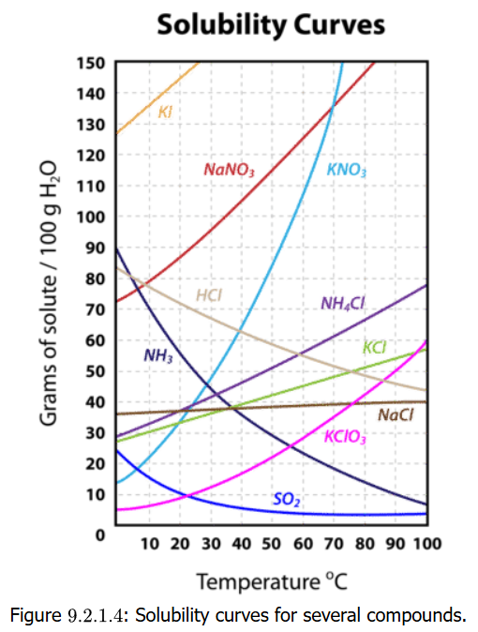
Solids Dissolved in Water
Solvent
Solute
Solution Types

Slide 24
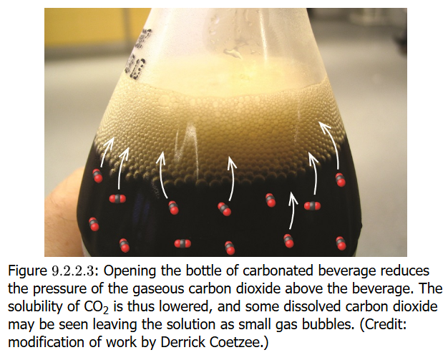
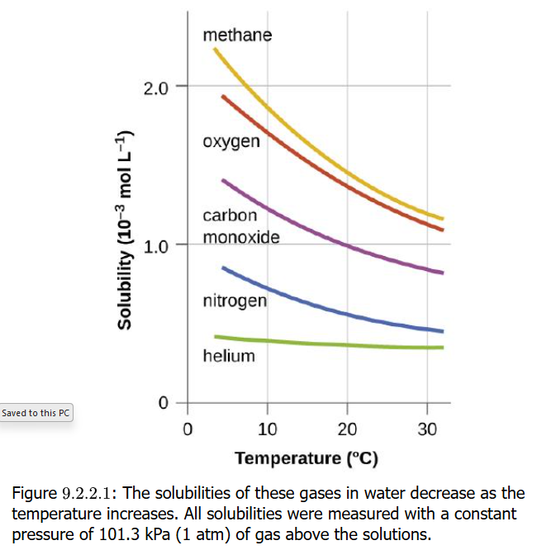
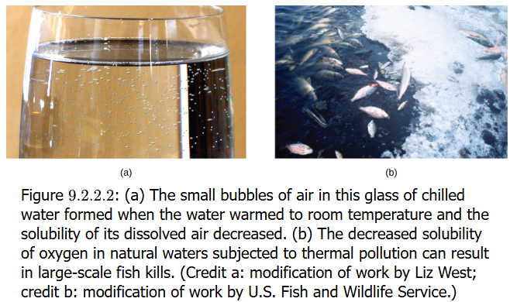
Gases Dissolved in Water
Solvent
Solute
Solution Types

Slide 25
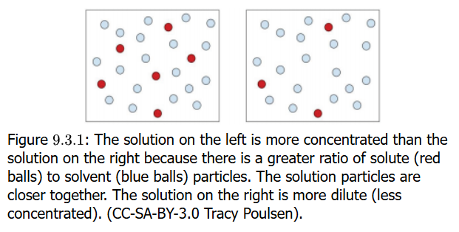
Concentration
Solvent
Solute
Solution Types

Slide 26
Percent Solutions
Solvent
Solute
Solution Types

Slide 27
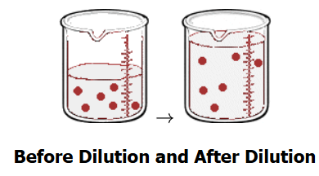
Dilutions of Solutions
Solvent
Solute
Solution Types

Slide 28
Colligative Properties: Molality
Solvent
Solute
Solution Types

Slide 29
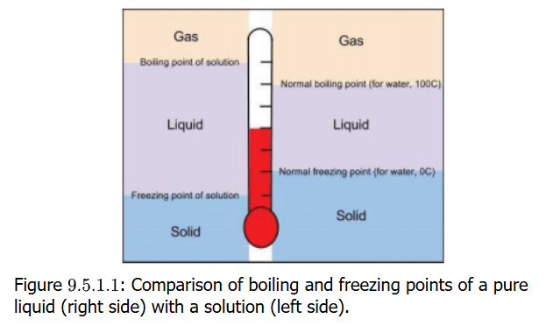
Freezing Point Depression
Solvent
Solute
Solution Types

Slide 30
Boiling Point Elevation
Solvent
Solute
Solution Types

Slide 31
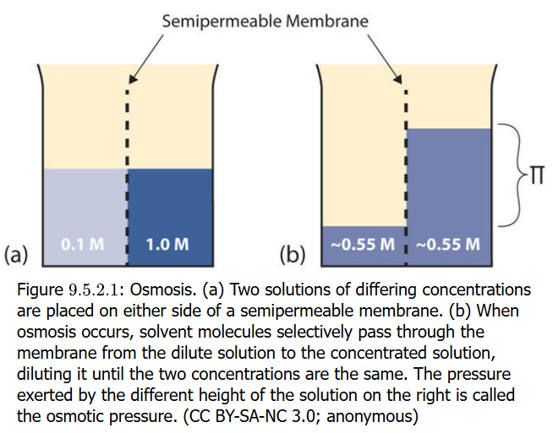
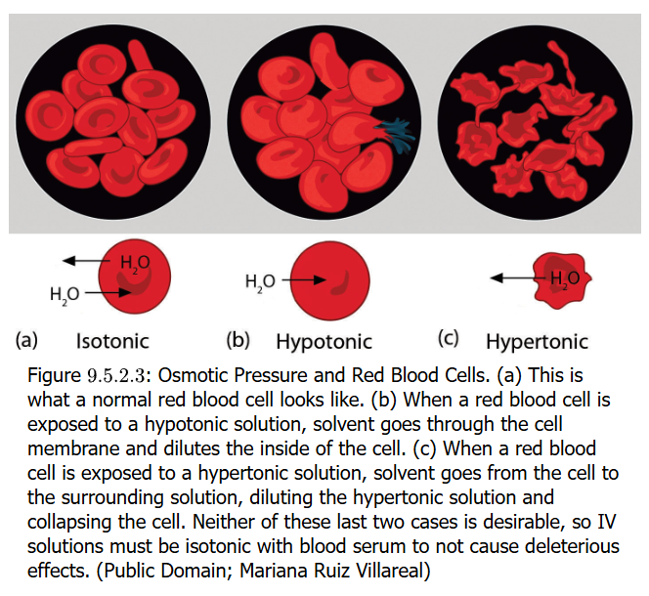
Osmosis
Solvent
Solute
Solution Types

